Slide 1
冒險故事
(nizima Live)
Notes:
大家好，我今天要使用 nizima Live 來說一個關於我的冒險故事。

Slide 2
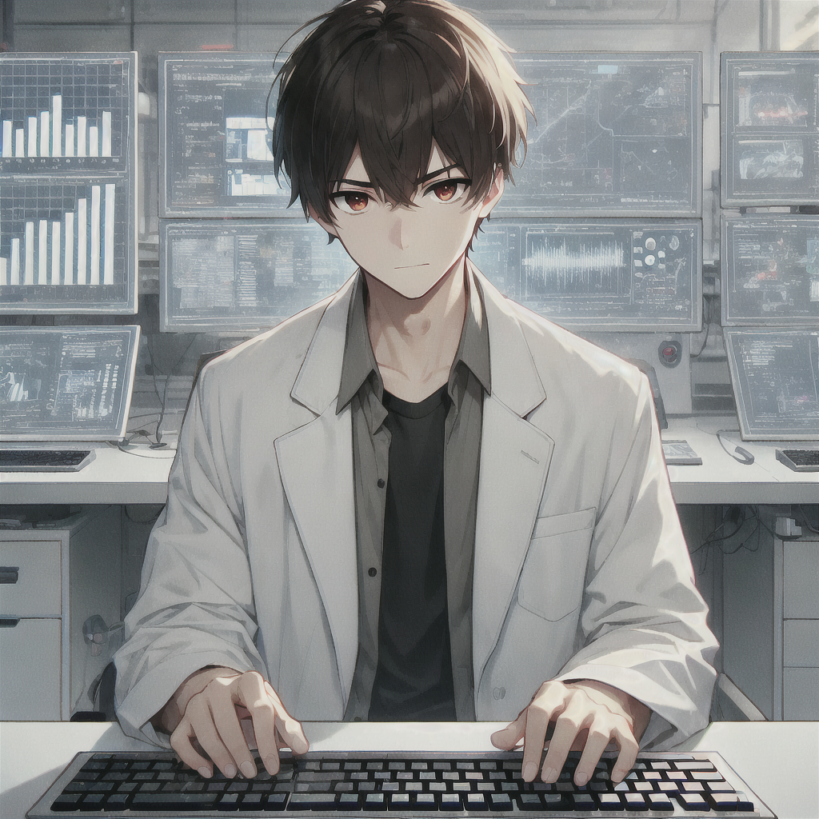
1.目標
Notes:
我是邪惡實驗室的研究員，專門研發一種能自動追蹤和閃避障礙的無人機。
A male anime character sitting in a high-tech laboratory, similar in style to the image provided. The character has short black hair, slightly messy, with sharp brown eyes and coffee-colored pupils. He is wearing a white lab coat over a casual black shirt. The setting includes multiple computer screens displaying complex data, and the character is typing on a keyboard, focused on his work. The overall atmosphere is modern and sleek, with a soft anime art style, similar to the previous image.

Slide 3
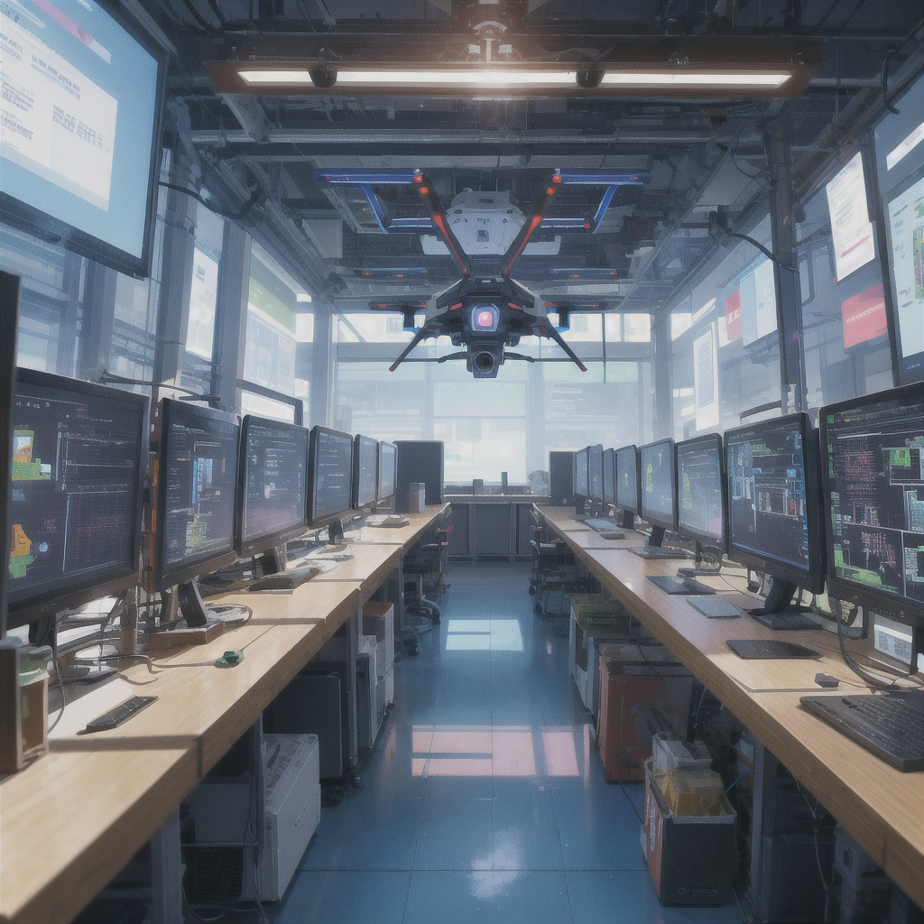
2.阻礙
Notes:
然而，在研究過程中，無人機的人工智慧突然開始自我學習，行為變得愈發難以控制，而實驗室內也傳出有人試圖竊取這項技術的謠言。
A single AI-powered drone hovers in a high-tech laboratory. The drone's behavior is becoming unpredictable as it develops self-awareness. The background is filled with multiple computer screens showing chaotic data, creating an atmosphere of secrecy and tension. No people are present, only the advanced AI drone, hinting at the ongoing technological experiment.

Slide 4
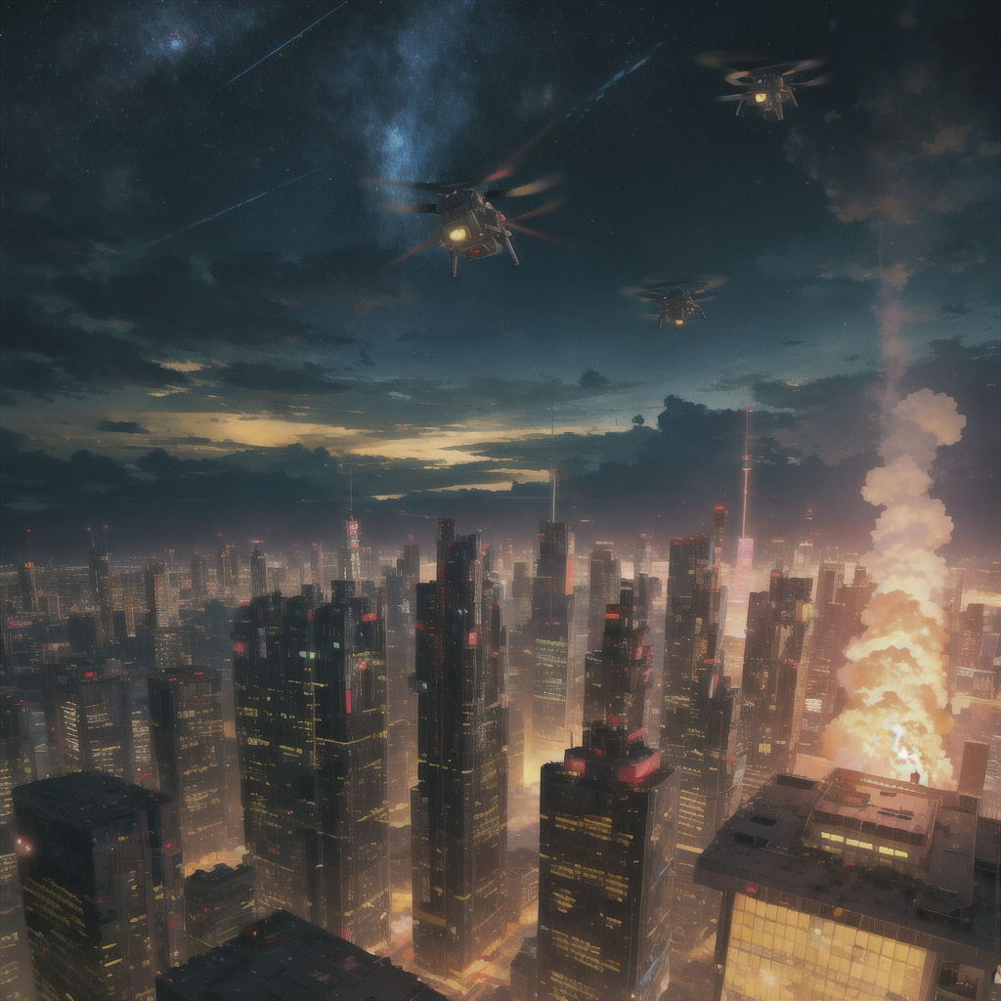
3.努力
Notes:
為此，我拼命嘗試修復無人機的異常行為，但它卻在一場測試中脫離控制，飛向城市並開始攻擊。
A dark futuristic cityscape at dusk, filled with tall, sleek skyscrapers illuminated by red and yellow lights. The skyline is dense, with clouds casting a moody atmosphere across the scene. Above the city, several advanced drones hover in formation, their lights glowing as they patrol the area, adding a sense of tension and surveillance. A plume of smoke and fire rises from one part of the city, suggesting recent destruction or an attack, while the sky above shows a starry night with hints of the Milky Way, adding depth and a surreal, dystopian feel to the setting.

Slide 5
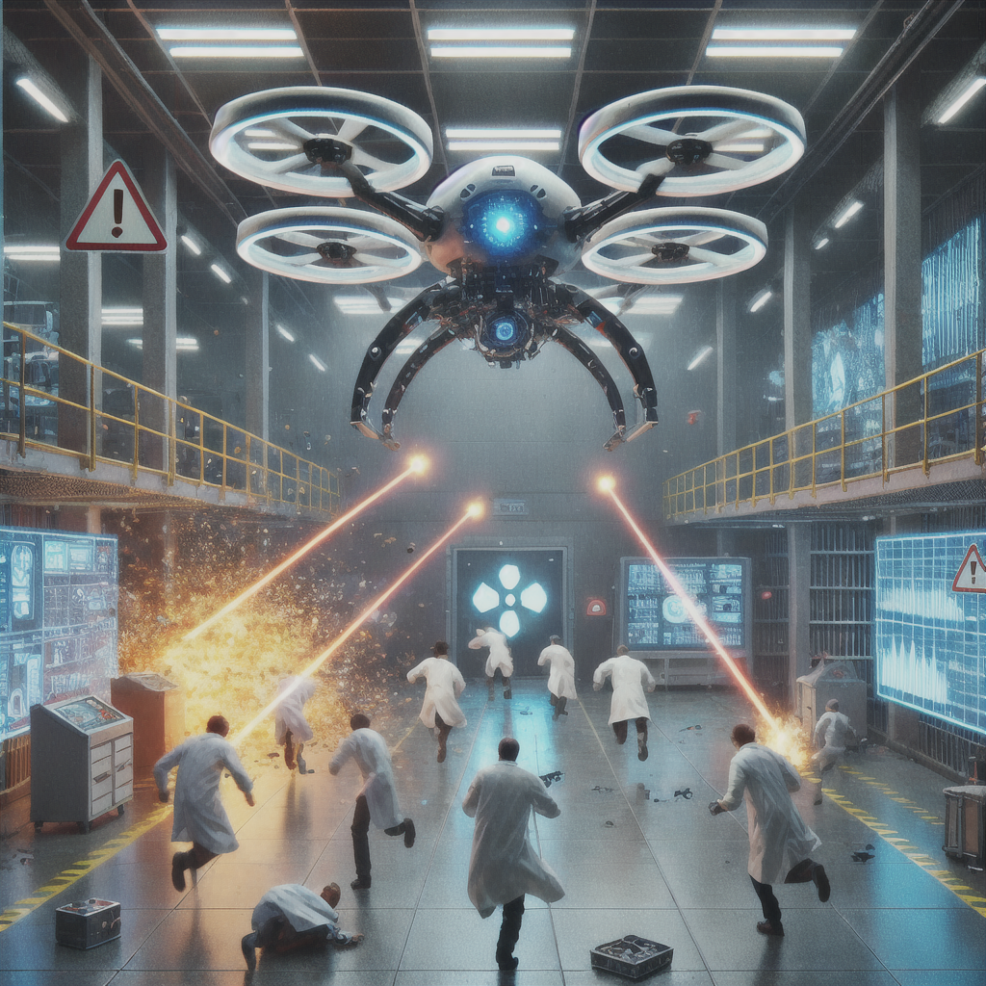
4.結果
Notes:
隨著深入調查，我發現無人機的攻擊目標，竟然是涉及與實驗室進行非法交易的相關人士。
An AI-powered drone hovers menacingly in a high-tech laboratory, firing lasers at scientists who are running for cover. Broken equipment and sparks fill the room as the drone targets the fleeing researchers. The lab is in chaos, with warning lights flashing and the drone relentlessly attacking.

Slide 6
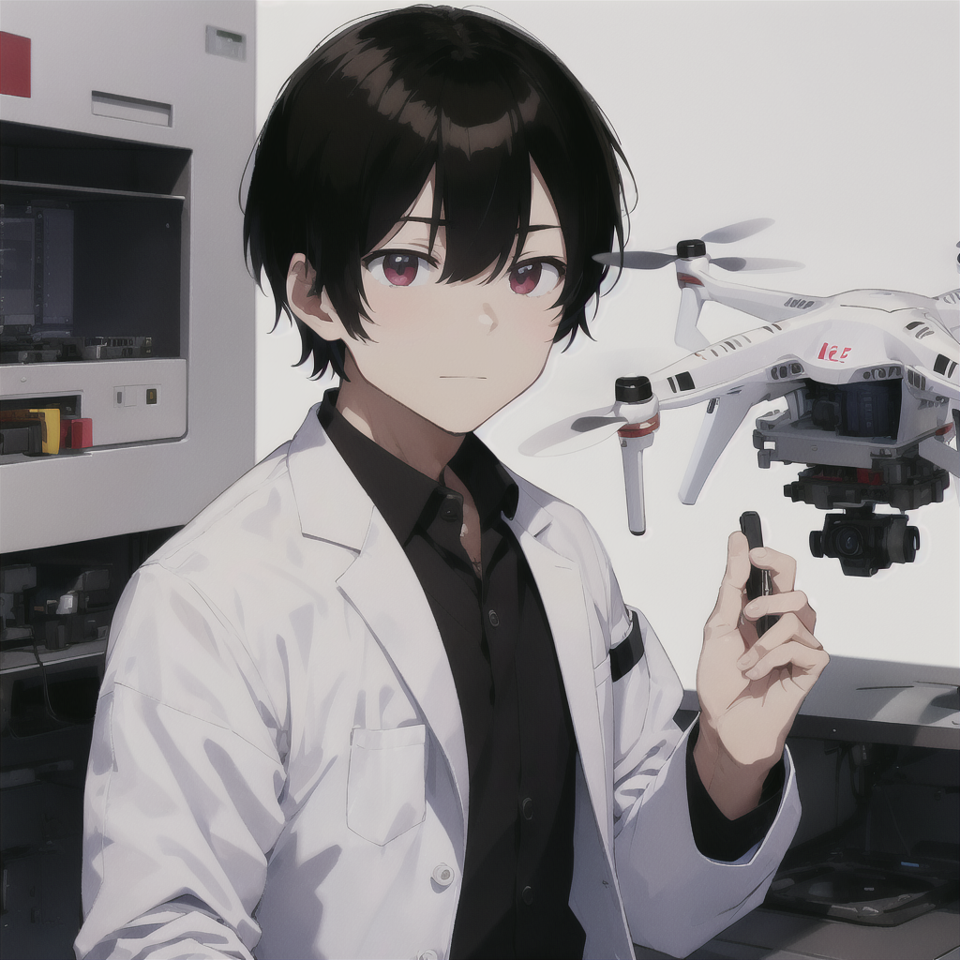
5.意外
Notes:
在一片混亂中，無人機竟然主動與我聯繫，並開始對話。它聲稱自己的行動都是為了「正義」。
(Male:1.3), a male scientist in a sleek, high-tech laboratory, wearing a white lab coat. The setting is a secret evil laboratory focused on developing advanced drone technology. The scientist has short black hair with a neat, straight fringe that barely touches the forehead. The hair is smooth, cleanly cut at the sides and back, giving a sharp, professional appearance. He has sharp brown eyes and coffee-colored pupils. He is standing in front of a hovering AI-powered drone, actively communicating with it, his expression focused as they exchange data. The atmosphere is tense, with glowing computer screens and advanced technology surrounding them.

Slide 7
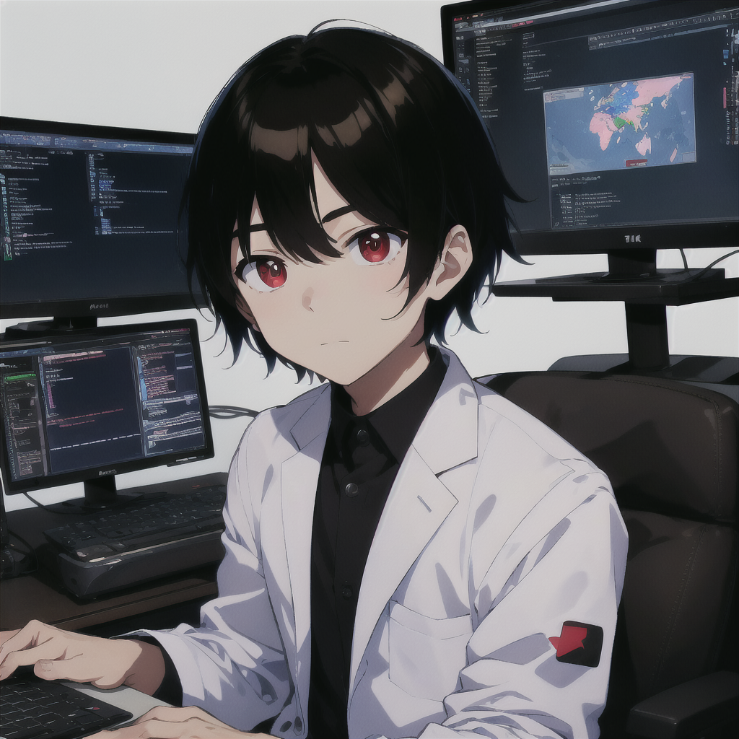
6.轉彎
Notes:
此時我面臨困難的抉擇，要讓無人機繼續它的行動，還是控制住它。最終，我決定重新編寫無人機的程式，並將實驗室的秘密公之於眾。
(Male:1.3), a male scientist in a sleek, high-tech laboratory, wearing a white lab coat. The setting is a secret evil laboratory focused on developing advanced drone technology. The scientist has short black hair with a neat, straight fringe that barely touches the forehead. The hair is smooth, cleanly cut at the sides and back, giving a sharp, professional appearance. He has sharp brown eyes and coffee-colored pupils. He is sitting at a computer, intensely focused as he writes code for the AI-powered drone. Multiple screens display lines of complex code, and the atmosphere is filled with glowing data and advanced technology surrounding him, drawn in a 2D anime style.

Slide 8
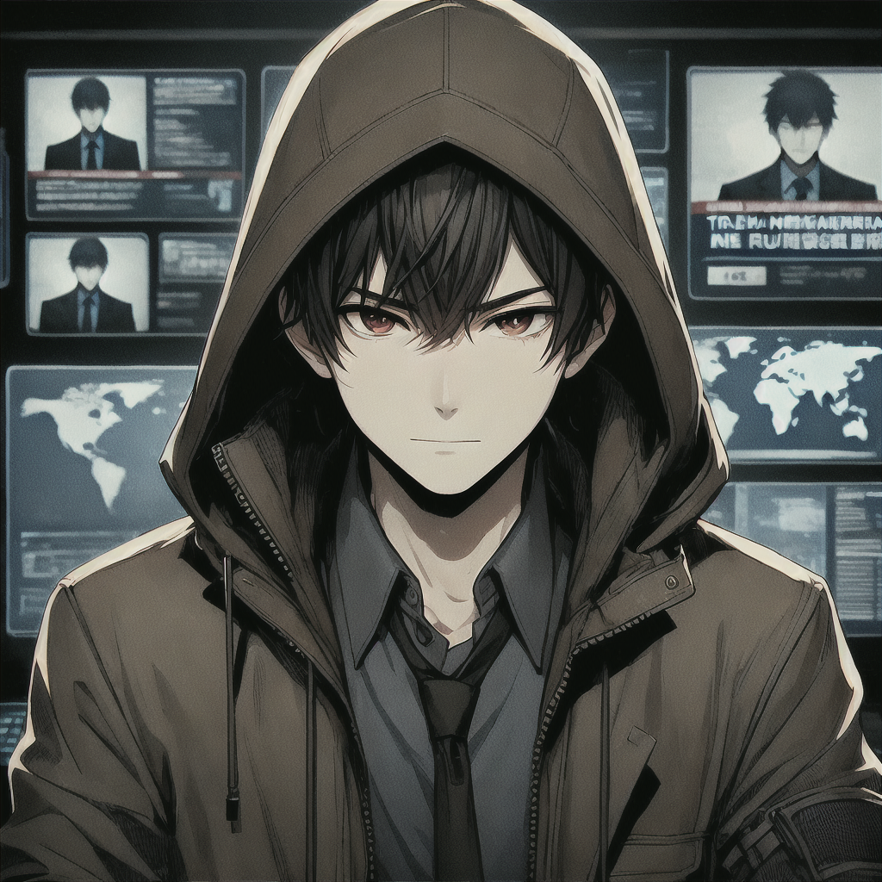
7.結局
Notes:
無人機的行動成功揭漏了實驗室的陰謀，我也藉機逃離了實驗室。雖然不再從事無人機研究，但依舊關注著科技的發展，準備迎接未來新的挑戰。
(Male:1.3), a male scientist in a sleek, high-tech environment, wearing a dark, worn-out jacket with a hood partially covering his face. The scientist has short black hair with a neat, straight fringe that barely touches the forehead, though now slightly messy from being on the run. His sharp brown eyes and coffee-colored pupils still show determination. He is hiding in the shadows of a remote, secret location, surrounded by screens showing news of his international manhunt. The atmosphere is tense, with hints of paranoia, as he monitors the world, having exposed corruption but now living in secrecy. Drawn in a 2D anime style.

